Slide 1
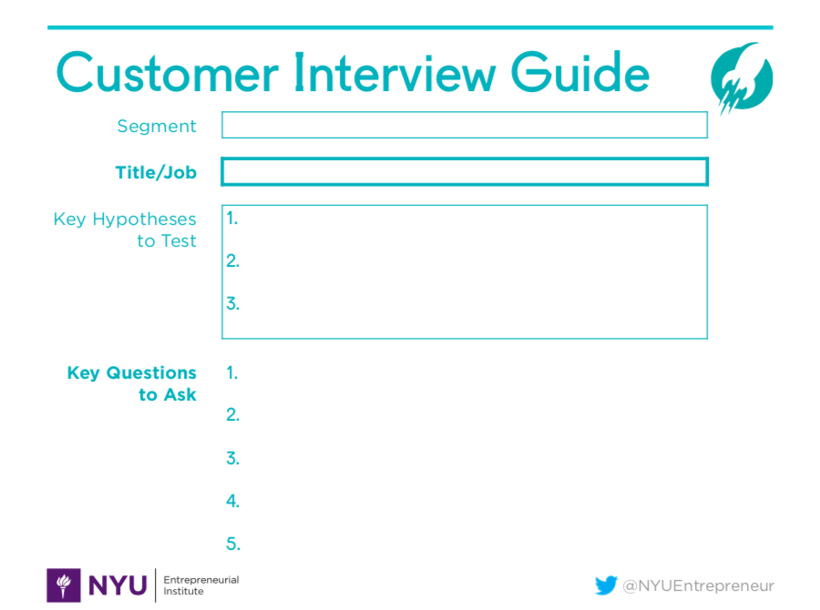
Parent of new driver
Parent of a new driver
Parents want to track their teen’s drivers
Parent’s care about teen driving weaknesses/ drive ranking
Parent’s care about being in control of data versus insurers having it
What are some of your biggest concerns as a parent?
What are your biggest safety concerns with your teen?
Do you track your teen’s driving today? Why? How?
Are they a good or bad driver? How did you come to that conclusion? What do they excel at and what do they need work on?
What concerns do you have with drive tracking products? What could they do better? How do you want your data protected?
How did your teen learn to drive? Tell me about that story.
Advice: Help brainstorm a more granular beachhead market(s)

